Slide 1


Team 60: Solar Lighting System
Bi-Weekly Update 1 Josh George, Jeb Malek, Lyric Haylow Sponsor: Dr. Wonhyeok Jang TA: Rhett Guthrie
Notes:
Michelle

Slide 2

Project Summary
85% of the world's energy comes from nonrenewable sources, sources that will eventually be depleted.
A need for clean, renewable sources becomes more apparent than ever.
Our home indoor and outdoor lighting system is the first step towards this, using solar power.
Notes:
Kyle

Slide 3
Project/Subsystem Overview
For our project, we will design a home lighting system that operates a variety of lights throughout both an inside foyer and an outside patio. The separate parts for the system to be considered are the battery, power conversion and regulation, mobile application functionality, BT microcontroller, and motion and light sensors for automated switching.
Notes:
Eric

Slide 4
Major Project Changes for 404
We lost a team member in 403, and they were in charge of the microcontroller. We'll use an Arduino to replace them.
Jeb will power and implement hardware of Arduino to project.
Josh will code Arduino for lighting system.
We dropped the flood light from the patio portion of the project. Deemed unnecessary addition after discussion between TAs and Sponsor. Now simply 2 lights on inside, one on outside.
Potential extra board for measuring battery percentage.
Notes:
Eric

Slide 5
Project Timeline
Jeb
PCB soldered and beginning testing
Josh
App interface and settings developed.
Specifics for settings need to be adjusted.
Bluetooth needs to be implemented
Lyric
Solar Charge Controller design made.
Design for PCB being finalized and parts already ordered.
3D print for microcontroller enclosure in process of being made.
Notes:
Eric

Slide 6
Solar Charge Controller
Lyric Haylow
Accomplishments since 403 22 hrs of effort | Ongoing progress/problems and plans until the next presentation
Previous design analyzed and checked by Prof Lusher, full report available. Parts for new board ordered, expected in less than a week. | Design and order new board within next 2 days Decide on action to take for battery reading portion, whether order or make. Begin soldering new board, to be at least %50 complete by next presentation.

Slide 7
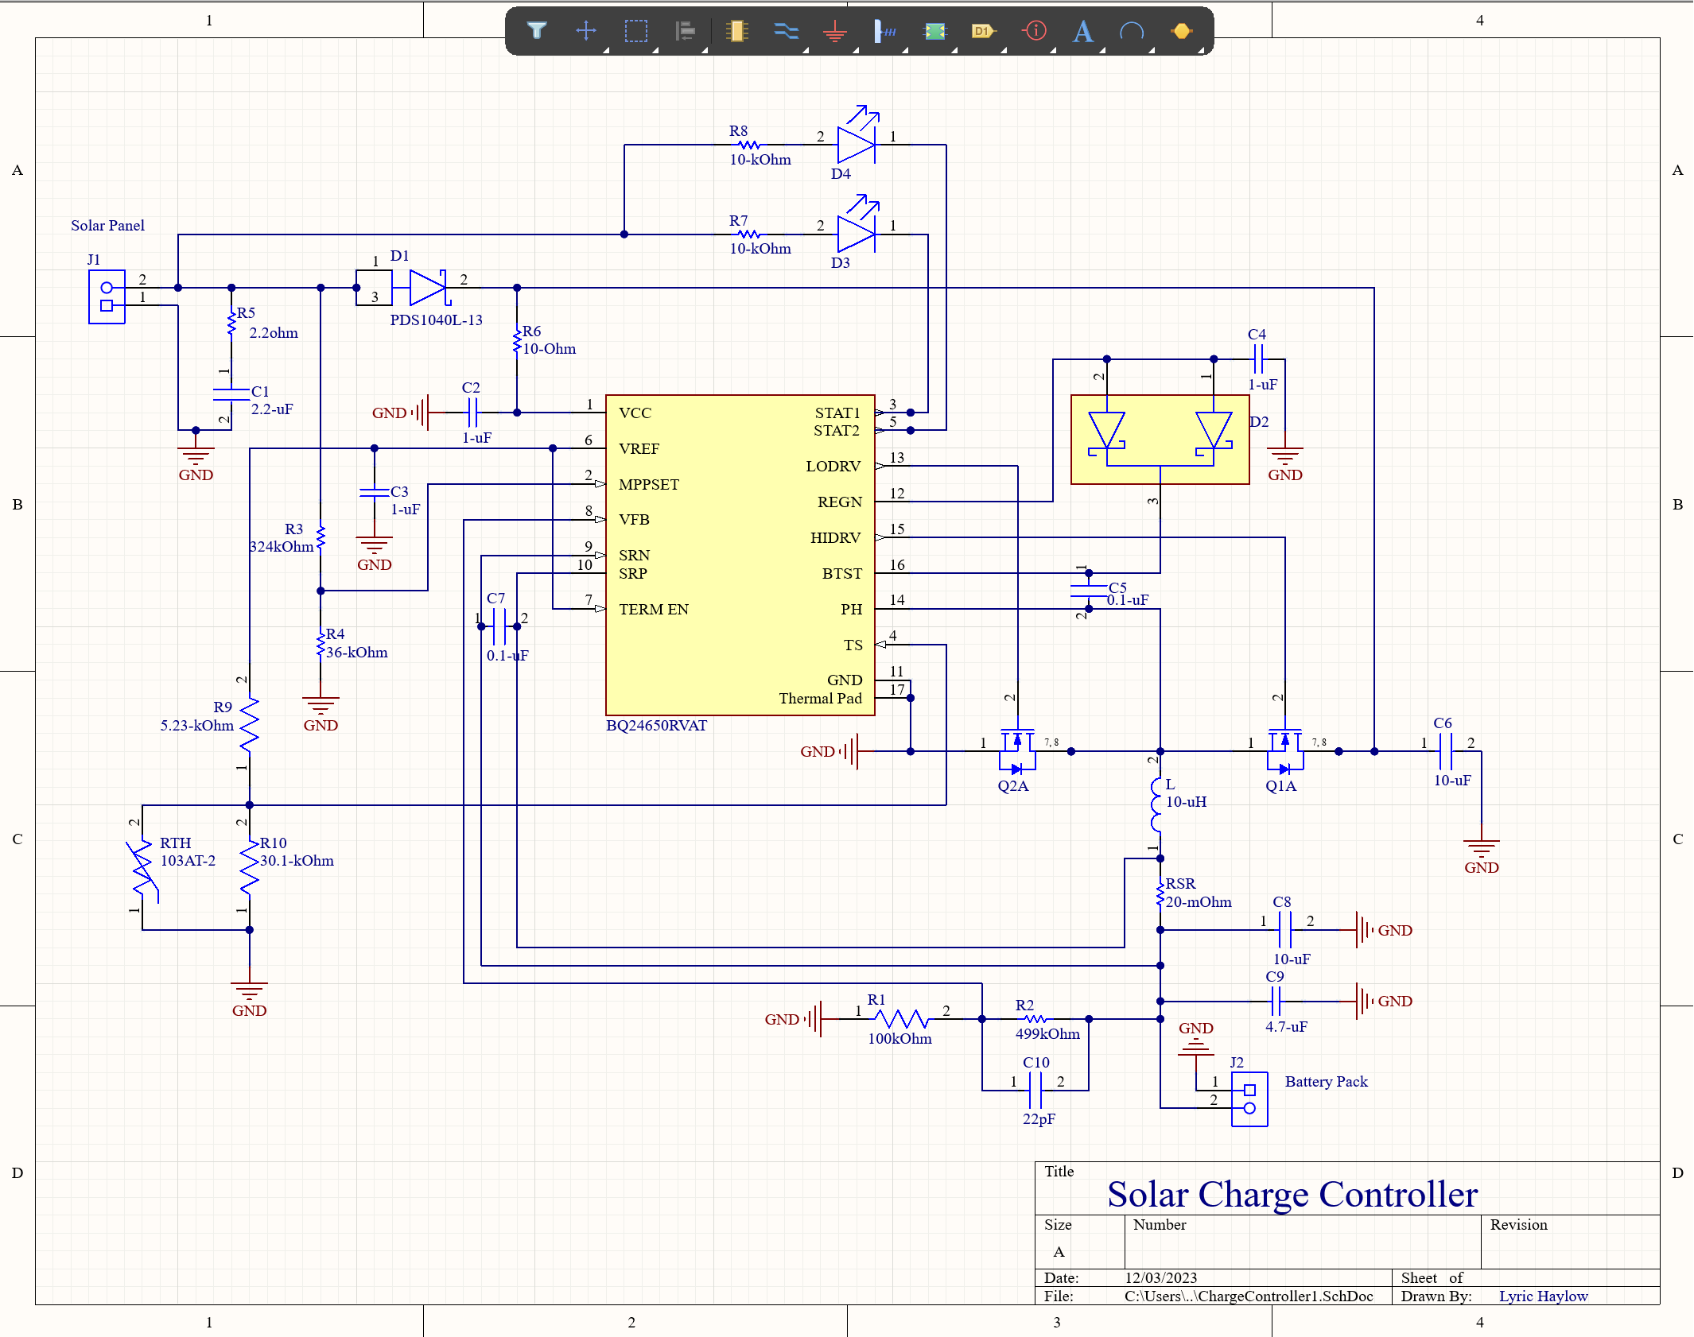
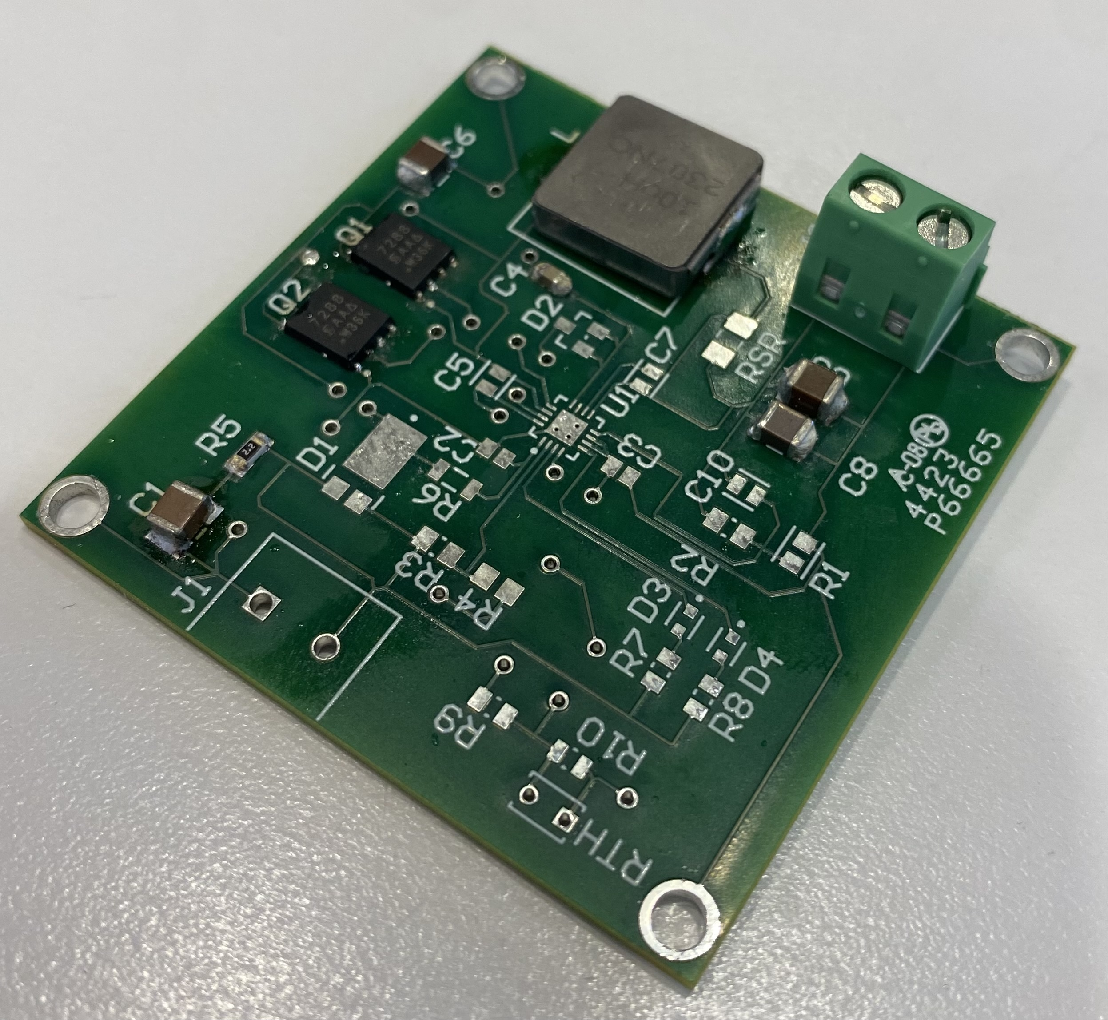
Solar Charge Controller
Lyric Haylow

Slide 8
Inverter Subsystem
Jeb Malek
Accomplishments since 403 60 hrs of effort | Ongoing progress/problems and plans until the next presentation
PCB Order Arrival All Parts Ordered/ Final Shipment In-Progress | Finish Board Assembly this week dsPIC in-circuit programming Begin Testing & Validation soon as MCU ICSP Programming Complete
Found multiple design flaws: Transformers / 0.1 uF Filter Capacitors Footpring issue , Part Order change orders
Discussed EMI Filter need , planned revision (PCB schematic updated)
Planning a 3D Print of Inverter Enclosure

Slide 9
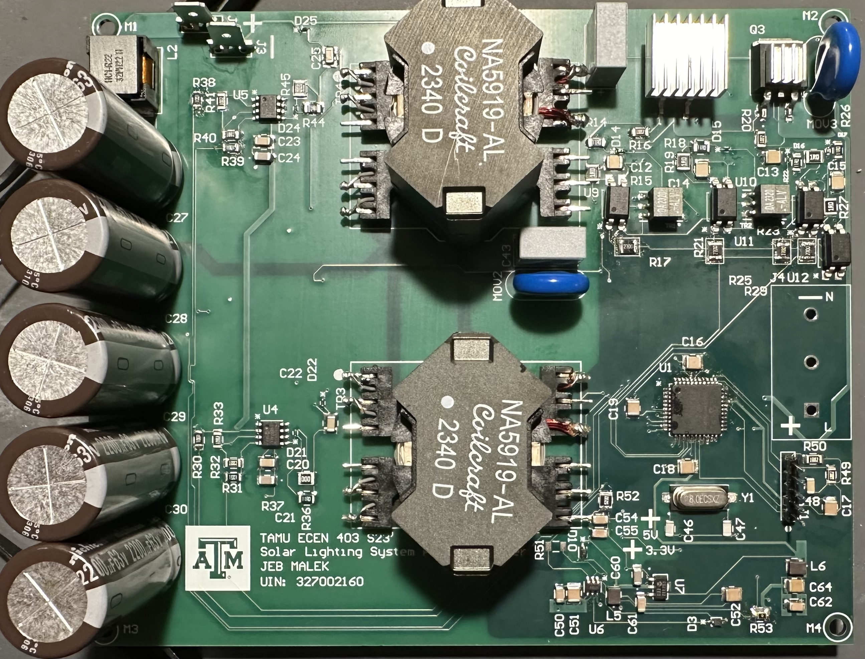
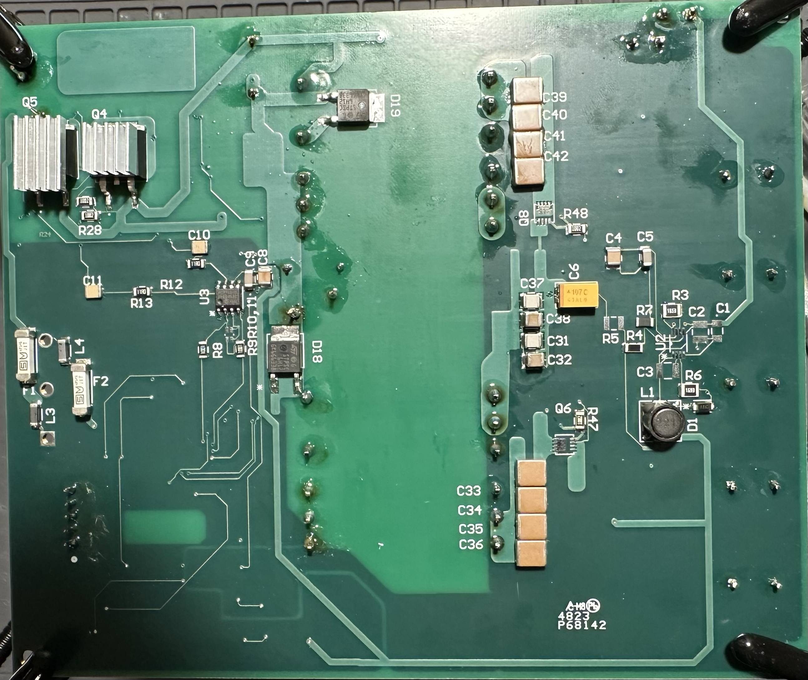
Inverter Subsytem
Jeb Malek

Slide 10
Mobile Application
Josh George
Accomplishments since 403 10 hrs of effort | Ongoing progress/problems and plans until the next presentation
-Added Bluetooth widget to landing page -Researched implementation of Bluetooth connection to Arduino Uno R3 -Added code to enable and display Bluetooth connections | -Work out errors with Bluetooth connectivity -Still unable to connect to Arduino board

Slide 11
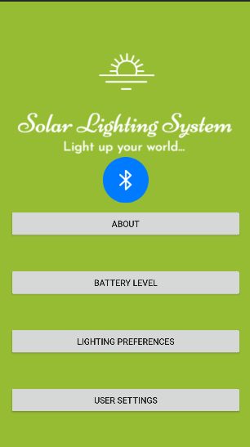
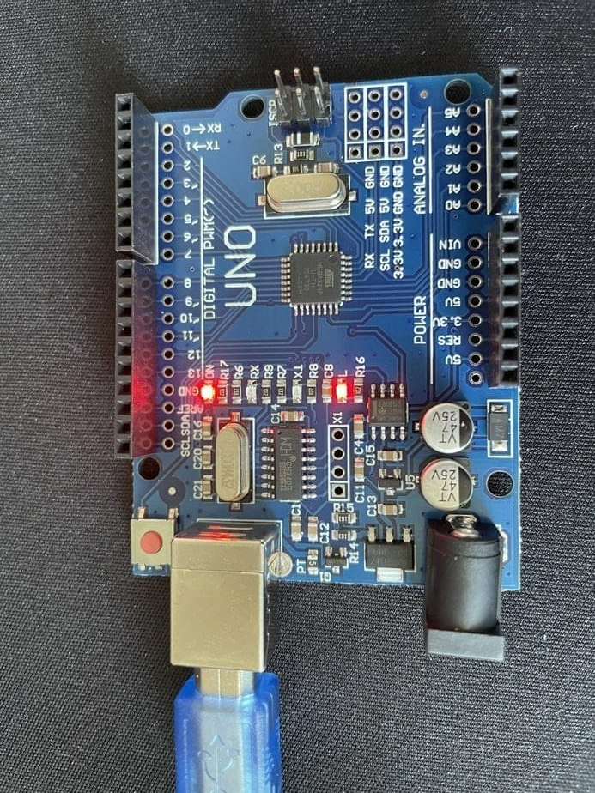
Mobile Application
Josh George

Slide 12
Parts Ordering Status
Full Part Shipment for Inverter expected : Week of 2/5
Parts for new Charge Controller PCB ordered as of 1/29, expected in a week.
Final Parts for preliminary version Inverter
Sensors need to be ordered.
Lights and sockets need to be ordered. Specific parts identified, verifying whether they are good currently.
Notes:
Michelle

Slide 13
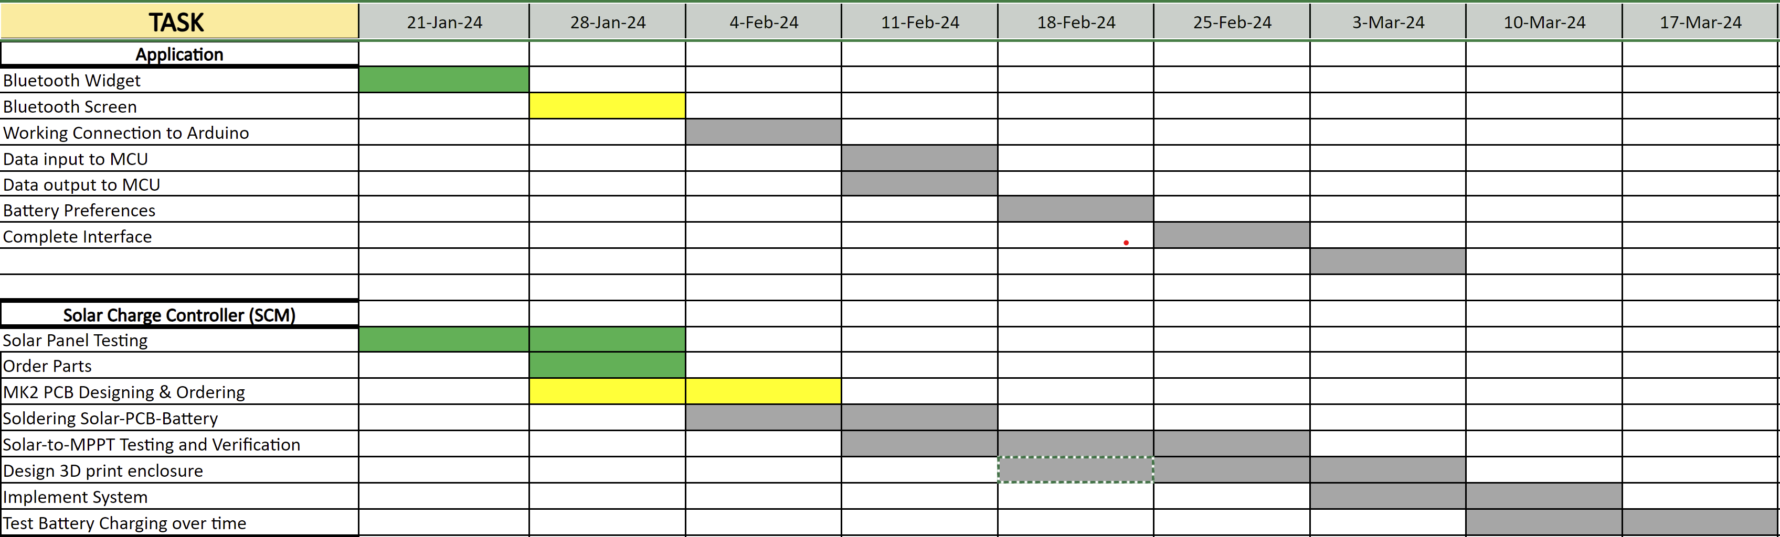
Execution & Plan
Notes:
Michelle

Slide 14
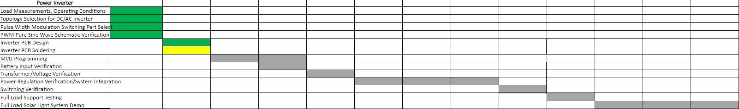
Execution Plan

Slide 15
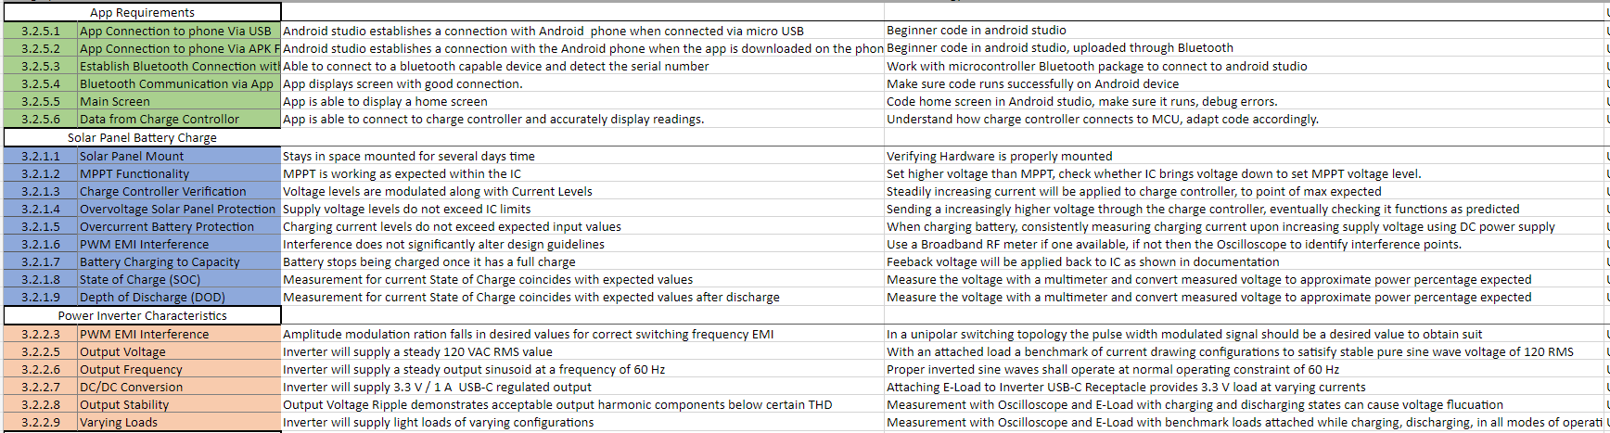
Validation

Slide 16
Thank you , 404 Classmates

